Slide 1
Intelligent Document Processing System(IDP)
Pendyala’s AI Hub 14-Dec-2025

Slide 2
Title: “Intelligent Document Processing System“
Your Name: Mr.Subrahmanya B Pendyala
Date: 14-Dec-2025
Notes:
Good morning, everyone. Thank you for taking the time to attend this presentation. Today, I am excited to introduce my Capstone Project: the Intelligent Document Processing System, or IDP.

Slide 3
Project Overview
Project Goal: To build an Intelligent Document Processing (IDP) System using Azure AI to automatically read and extract key information (like totals, names, and tables) from documents such as invoices and receipts.
Core Technology: The system relies on Azure AI Document Intelligence (which includes advanced Optical Character Recognition, or OCR) to structure the data.
Key Outcome: It eliminates the need for manual data entry, allowing the computer to handle the repetitive task of reading documents.
Business Value: This drastically speeds up crucial financial processes like Accounts Payable and claims processing, saving time and reducing human errors.
Notes:
This Capstone Project, the Intelligent Document Processing (IDP) System, is a practical application of my MS ADT with AI Specialization.
Our primary goal is to automate text and tabular data extraction from documents like invoices and receipts. The core technology is Azure AI Document Intelligence, utilizing its advanced OCR capabilities.
The solution operates in two main phases:
Automated Processing (Steps 1-5): Documents are uploaded via a Servlet UI, stored in Azure Blob Storage, and an Azure Function is triggered to call Document Intelligence for analysis. A second function then routes high-confidence data ($\ge 95\%$) straight to the Azure SQL Database.
Exception Handling (Steps 5-7): Low-confidence documents are routed to a Human Review Queue. A reviewer corrects the data via a separate UI/Servlet and submits the final output to the database.
The business value is clear: we significantly reduce manual data entry and accelerate Accounts Payable and claims processing, leading to huge time savings and fewer errors."

Slide 4
Solution Architecture- Data Flow
Data Flow Steps
Ingestion : User uploads document via JSP/Servlet.
Storage: Document lands in Azure Blob Storage Input Container (raw-uploads).
Trigger : Blob creation event triggers Azure Function .
Analysis: Azure Function calls Azure AI Document Intelligence to extract structured data and ingest into Azure SQL Database.
Notes:
The project's primary goal is to automate text and data extraction from documents like invoices and receipts. We use Azure AI Document Intelligence (with advanced OCR) as the core technology. This eliminates the need for manual data entry.
The system flow is: Documents are uploaded via a Servlet UI, stored in Azure Blob Storage, triggering an Azure Function for analysis. Validation follows, routing high-confidence data straight to the DB. Low-confidence data goes to the Human Review Queue. A Reviewer corrects this data via a Servlet UI before final ingestion into Azure SQL Database.
This drastically accelerates Accounts Payable and claims processing, saving time and reducing human errors.

Slide 5
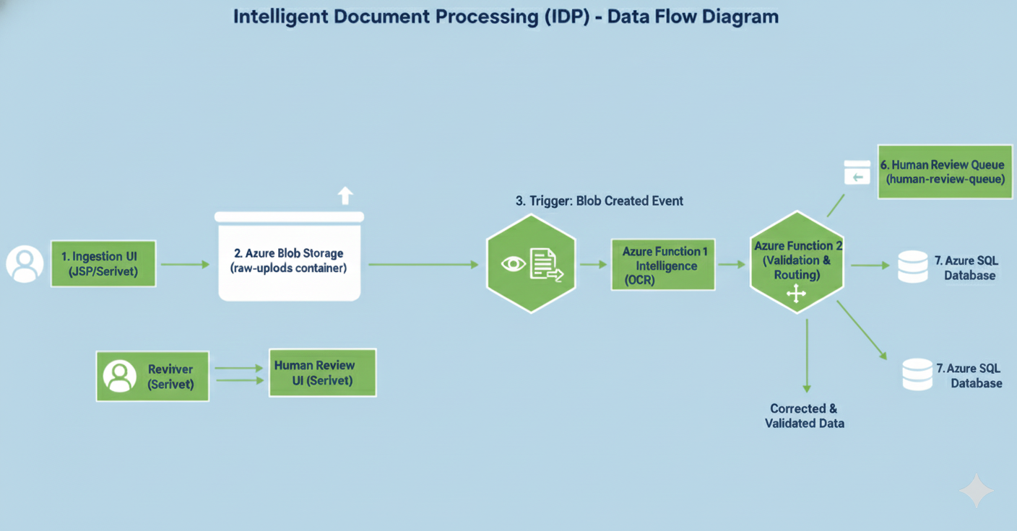
Solution Context Diagram
Notes:
This diagram shows the complete, step-by-step process of our Intelligent Document Processing system.
Ingestion: The user starts the process by uploading a document via the Ingestion UI, which is a simple JSP/Servlet interface.
Storage: The document is immediately stored in Azure Blob Storage in the raw-uploads container.
Automation Trigger: The moment the file lands, it triggers an event that starts Azure Function 1.
Analysis: This function calls Azure AI Document Intelligence (our OCR core) to extract the structured data.
Routing: Azure Function 2 checks the extraction confidence. If it's high (95% or more), the data goes straight to the Azure SQL Database.
Human Review: If the confidence is low, the data is routed to the Human Review Queue. A reviewer uses a separate Servlet UI to correct the data.
Final Output: Whether automated or manually corrected, the validated data is finally saved into the Azure SQL Database.

Slide 6
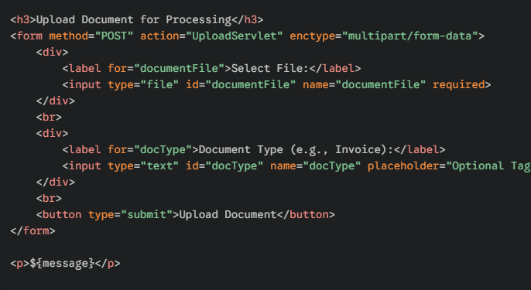
Upload Form
Notes:
This slide shows the Ingestion UI, the very first step of our IDP system, implemented using a simple JSP page.
The goal of this page is straightforward: to allow the user to select and upload a document to be processed.
Select File: The user clicks the 'Select File' button to choose an invoice or receipt from their local computer. This is a standard HTML file input.
Document Type (Optional): We include an optional field where the user can tag the document, which can help in routing or model selection later in the Azure pipeline.
Submission: When the user clicks 'Upload Document,' the data is sent to the UploadServlet. The Servlet then takes this file and pushes it directly into Azure Blob Storage, officially starting the entire automated workflow

Slide 7
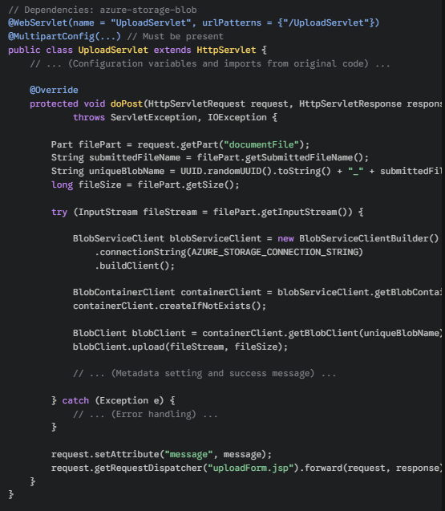
Backend – Upload Servlet
Notes:
This slide shows the key Java code for the UploadServlet, which is the backend that handles the file submission from the JSP page.
File Reception: The servlet first receives the uploaded file content using request.getPart("documentFile").
Unique Naming: It generates a universally unique name for the file using UUID.randomUUID() to prevent any conflicts in storage.
Azure Connection: It establishes a secure connection to Azure using the BlobServiceClientBuilder and the connection string.
Storage Logic: It ensures the raw-uploads container exists, gets a client for the new file, and then executes the critical blobClient.upload() command.
This step successfully moves the user's document from the web browser to Azure Blob Storage, fulfilling the Ingestion and Storage steps (1 and 2) and setting up the Blob Created Event (step 3) that triggers the rest of the automated pipeline.

Slide 8
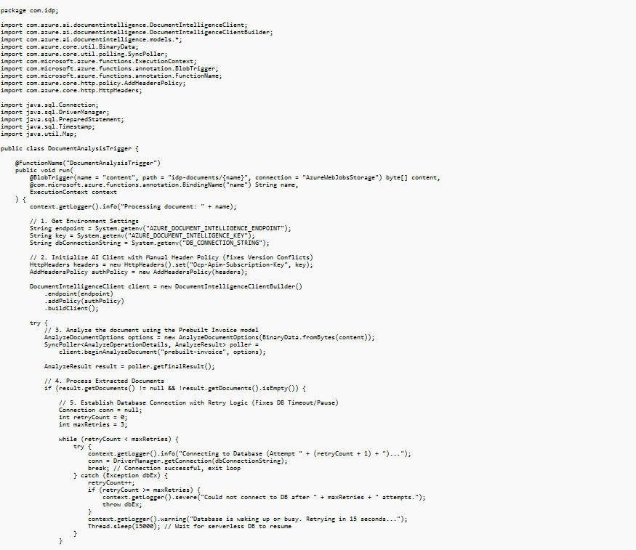
Azure Function – Analysis Trigger
Notes:
Key Steps in the Workflow
The Trigger: The process starts automatically the moment a file is uploaded to a specific Azure storage folder.
The Brain (AI Integration): The code sends the document to Azure AI Document Intelligence. We specifically use the "prebuilt-invoice" model, which is already trained to find things like vendor names and total amounts.
The Safety Net (Retry Logic): Databases sometimes "sleep" to save costs. This code includes a "retry loop"—if the database is busy or waking up, the code waits 15 seconds and tries again rather than just failing.
Data Extraction: Once the AI finishes reading, the code pulls out three specific pieces of info: Vendor Name, Total Amount, and Invoice Date.
The Final Save: It takes those details and saves them into a structured SQL database table for the business to use.

Slide 9
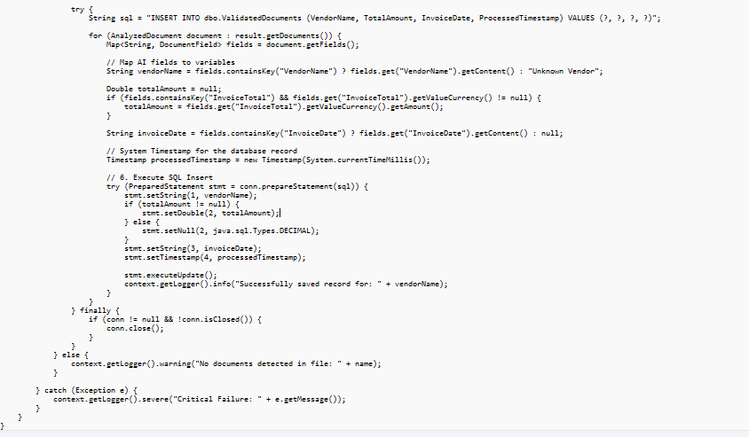
Azure Function – Analysis Trigger (Contd)
Notes:
Key Steps in the Workflow
The Trigger: The process starts automatically the moment a file is uploaded to a specific Azure storage folder.
The Brain (AI Integration): The code sends the document to Azure AI Document Intelligence. We specifically use the "prebuilt-invoice" model, which is already trained to find things like vendor names and total amounts.
The Safety Net (Retry Logic): Databases sometimes "sleep" to save costs. This code includes a "retry loop"—if the database is busy or waking up, the code waits 15 seconds and tries again rather than just failing.
Data Extraction: Once the AI finishes reading, the code pulls out three specific pieces of info: Vendor Name, Total Amount, and Invoice Date.
The Final Save: It takes those details and saves them into a structured SQL database table for the business to use.

Slide 10
Step by Step Instructions for Creating App Service Plan in Azure
Notes:
What is an App Service Plan?
Think of the App Service Plan (ASP) as the engine room or the "server farm" where your web application lives and runs. It defines the physical resources—like the operating system, region, and price—that your app will use.
+1
The Setup Process
Find the Service: Log into the Azure Portal and search for "App Service plan" to start the creation process.
+1
Organize Your Project: Select your active subscription and the specific Resource Group you’ve dedicated to your project components.
Choose Your Environment: * Name: Give it a unique name (e.g., IDP-Java-ASP).
OS: For Java applications, Linux is the recommended choice.
Region: Pick the same location (like East US) as your other services to keep everything fast and reduce lag.
Pick a Pricing Tier: This is a crucial step. While "Standard" is often the default, you should click "Change size" to pick a tier that fits your needs. For testing, the Basic (B1) tier is usually sufficient.
+2
Finalizing
Review your settings—specifically the OS and Pricing Tier—and click Create. Once it’s ready, you can plug your actual web app (the WAR file) into this plan.
+1

Slide 11
Step by Step Instructions for Creating Blob Storage and Azure SQL Instance
Notes:
we’re setting up two critical Azure components: Blob Storage for our raw files and SQL Database for our final structured data.
+1
Part 1: Azure Blob Storage (The Filing Cabinet)
Think of this as your cloud-based hard drive.
The Basics: When creating your storage account, give it a unique name and pick a region close to you to keep things fast.
Containers: Once it's built, create a folder called raw-uploads. This is exactly where our application will drop files for processing.
+2
The Key: To let our app talk to this storage, we need to copy the Connection String from the "Access keys" menu. This is the "password" our code uses to log in.
Part 2: Azure SQL Database (The Data Vault)
This is where the AI will save the final, organized information it finds.
Server Setup: You’ll need to create a new server and set up an admin username and password. Keep these credentials safe as you’ll need them later.
+2
Connectivity (The "Crucial" Step): Under the Networking tab, you must select "Public endpoint" and set "Allow Azure services... to access this server" to Yes. Without this, your Azure Functions won't be able to save data to the database.
+1
JDBC String: Finally, copy the JDBC connection string. Since we are using Java, this specific string is what our application needs to find and talk to the database.
+1

Slide 12
Step by Step Instructions for Deploying WAR file in Azure
Notes:
Deploying Your Java Web App to Azure
This final stage is where we take our local Java code and make it live on the internet using a WAR file.
+1
The Deployment Workflow
Packaging the App: First, we bundle all our code, pages, and settings into a single file called a WAR (Web Application Archive). Think of this as a zip folder designed specifically for web servers.
+1
Setting up the Host: In the Azure Portal, we create an App Service. We must select Java as our runtime and Tomcat as our web server, which acts as the container that runs our code.
+1
Connecting the Dots: Under "Configuration," we must add our Environment Variables. This includes the storage connection strings and database links we gathered earlier. This allows the app to talk to the rest of our Azure tools securely.
Uploading the File: To get our code onto the server, we can use an FTP client like FileZilla. We simply drop the WAR file into the /site/wwwroot/webapps/ folder, and the server will automatically start it up.
Verifying Success
Once uploaded, we visit our app’s URL. We need to test the Ingestion UI to see if file uploads work and the Reviewer UI to ensure our data logic is pulling information correctly from the database.

Slide 13
Step by Step Instructions for Deploying Azure Functions

Slide 14
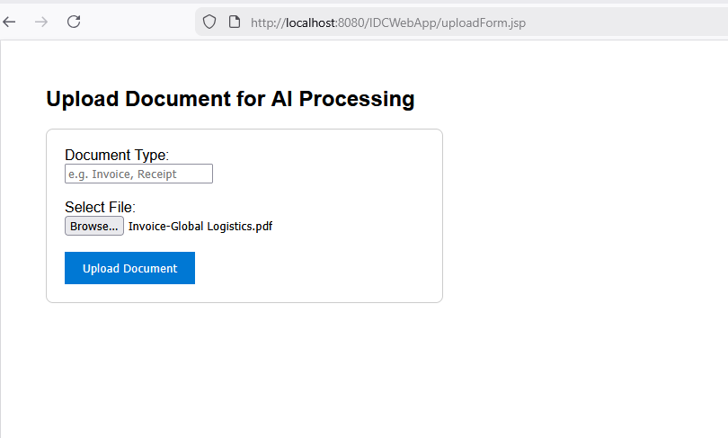
Screenshots of Results- File Upload
Notes:
This screen represents the Ingestion UI, the front-facing part of the application where the process begins. It is a simple, user-friendly interface designed for non-technical users to submit documents for AI analysis.
Document Entry: Users can specify the document type, such as an "Invoice" or "Receipt," to help categorize the data.
File Selection: The "Browse" button allows users to select a specific file from their computer, like the "Invoice-Global Logistics.pdf" seen here.
Triggering the Workflow: Clicking Upload Document sends the file to the Azure Blob Storage "raw-uploads" container.
Automated Start: This single click is what triggers the entire automated backend—from the AI reading the text to saving the data into our SQL database.

Slide 15
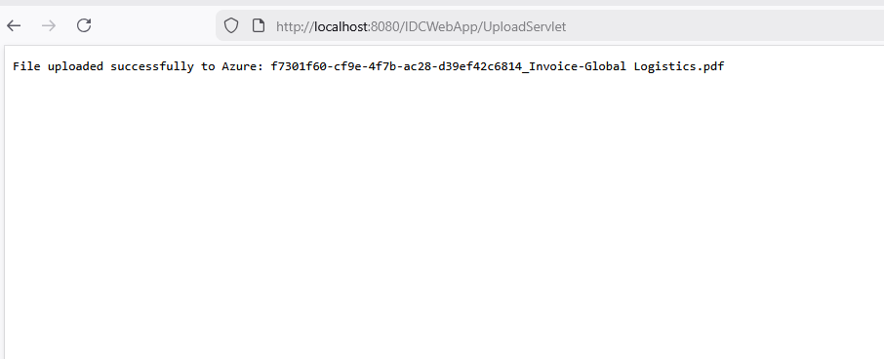
Screenshots of Results- Upload Status
Notes:
The Ingestion UI: From Upload to Cloud
These screens show the User Interface (UI) where our document processing journey begins.
User Entry: The first screen is a simple web form where a user selects a document type and browses for a file, like the "Invoice-Global Logistics.pdf" shown here.
The Action: When the user clicks Upload Document, the system packages the file and sends it to our Azure Blob Storage.
Confirmation: The second screen confirms the upload was successful, showing a unique ID generated for the file.
The Invisible Trigger: Behind the scenes, this successful upload is exactly what wakes up our Azure Function to start the AI analysis.
This simple interaction replaces manual data entry by kicking off the entire automated pipeline.

Slide 16
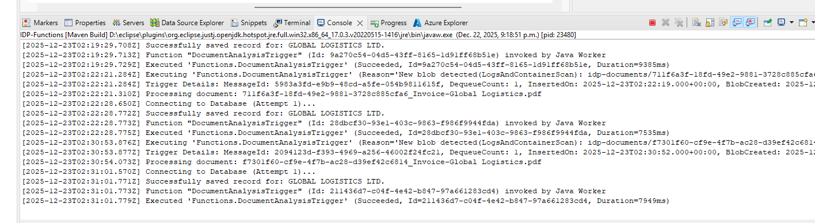
Screenshots of Results- Output Logs
Notes:
Behind the Scenes: The Execution Logs
This screen displays the system logs, which provide a real-time "heartbeat" of our automated process. It proves that the code we discussed is working exactly as planned.
Triggering the Function: You can see the DocumentAnalysisTrigger being "invoked" the moment it detects a new file in the storage container.
Database Connectivity: The logs show the "Connecting to Database" step, confirming the system is establishing a secure link to save the results.
Successful Processing: Each entry ending in "Successfully saved record" means the AI successfully read the invoice and the data—like "GLOBAL LOGISTICS LTD"—is now safely stored in our SQL database.
Speed and Efficiency: Notice the "Duration" timestamps; the entire AI analysis and database save happens in just a few seconds.

Slide 17
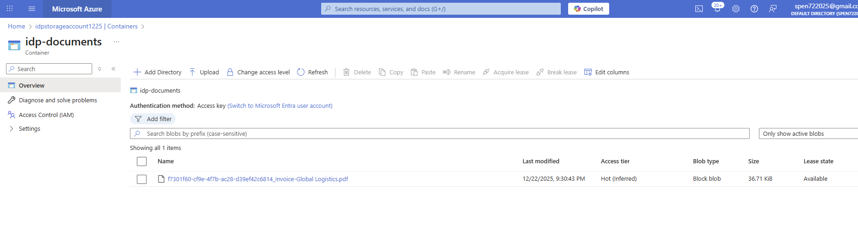
Screenshots of Results- Blob Storage Container
Notes:
Azure Storage: The Document Landing Zone
This screen shows the Azure Blob Storage portal, specifically the container where our uploaded files are kept.
Central Storage: After a user uploads a document through the UI, it arrives here in the idp-documents container.
Verification: You can see the specific file—"Invoice-Global Logistics.pdf"—sitting in the list, confirming that the transfer from our web app to the cloud was successful.
Trigger Mechanism: The presence of this file is what the Azure Function is constantly watching for. As soon as it appears, the AI processing starts automatically.
Metadata: The portal tracks when the file arrived and its size, providing an audit trail for every document enterring the system.

Slide 18
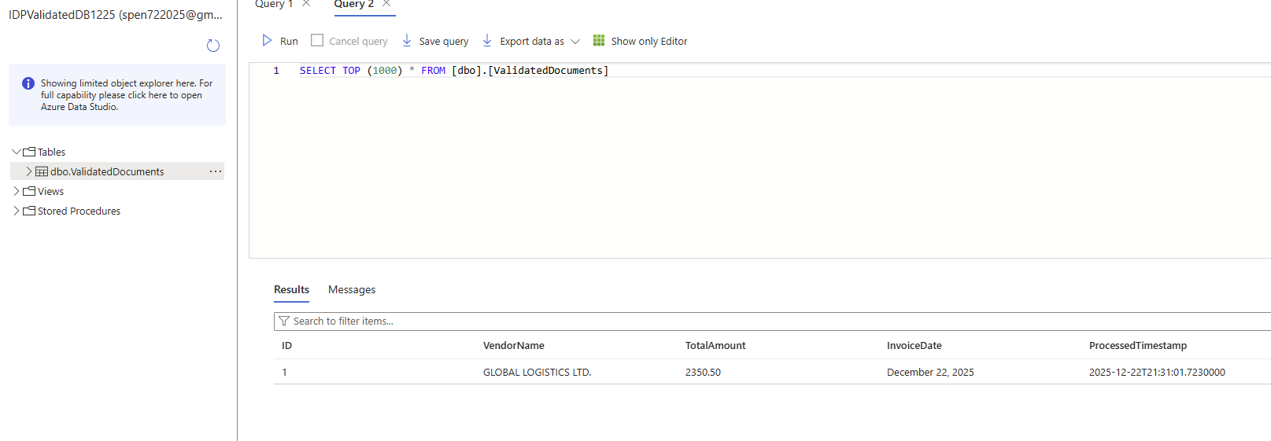
Screenshots of Results- DB Table Snapshot in Azure SQL DB
Notes:
he Final Destination: Your Validated Data
This screen displays the Azure SQL Database Query Editor, showing the final result of our automated pipeline. It is the "vault" where our structured data now lives.
Data Confirmation: By running a simple search, we can see that the AI successfully extracted key details from the invoice—specifically the Vendor Name (GLOBAL LOGISTICS LTD.), the Total Amount (2350.50), and the Invoice Date.
Automatic Recording: You’ll notice the ProcessedTimestamp column; this was automatically generated by our code to track exactly when the document was handled.
Ready for Business: This data is no longer trapped in a PDF. It is now in a clean, digital format that can be used for financial reports, payment processing, or audits without any manual typing

Slide 19
Next Steps
This application takes an input file from a web UI and the file
is uploaded to Azure Blob Storage container.
An Azure Function is triggered by a Blob Storage Event and
The function invokes Azure AI Document Intelligence Service .
The output from the AI Service is extracted into the individual fields and ingested into a DB for summarized analysis.
As Next Step, a human review process can be added to the flow if the confidence threshold is below a certain value.

Slide 20
References
MS Learn Documentation on Microsoft Azure AI Services
MS Learn Documentation on Microsoft Azure Cloud Services

